Slide 1
SECOND SEMESTER
MATHEMATICS II
07
Area Between Curves
Dr. Shaimaa Amen / 1st year/ Material engineering department
2020-2021

Slide 2
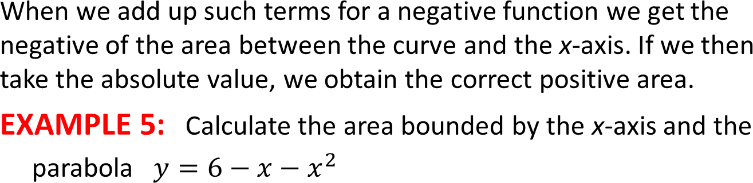
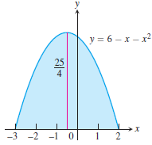
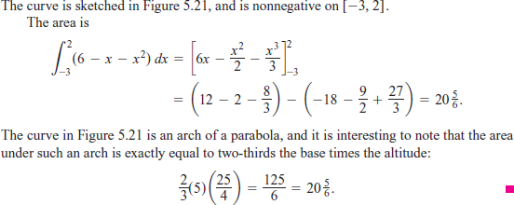
Total Area
Solution:

Slide 3
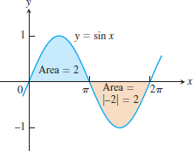

EXAMPLE 6:
Figure, shows the graph of the function ƒ(x) = sin x between x = 0 and
x = 2π Compute
the definite integral of ƒ(x) over [ 0, 2π]
the area between the graph of ƒ(x) and the x-axis over [ 0, 2π]

Slide 4
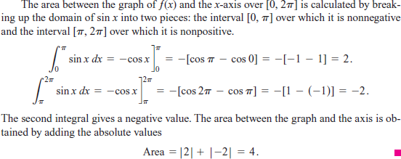
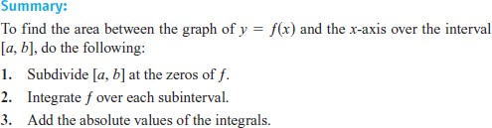

Slide 5
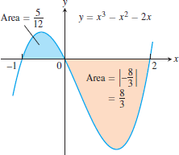

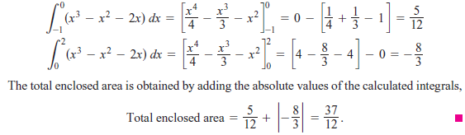
EXAMPLE 7:
Find the area of the region between the x-axis and the graph of
ƒ(x) = x3 - x2 - 2x,
Solution:
We integrate ƒ over each subinterval and add the absolute values of
the calculated integrals.

Slide 6




EXERCISES 5.4:
1. Evaluate the integrals in Exercises.

Slide 7

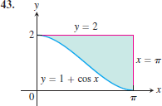
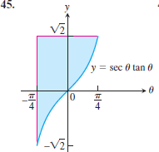
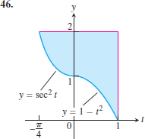
2. In Exercises, find the total area between the region and the x-axis.
3. Find the areas of the shaded regions in Exercises.

Slide 8


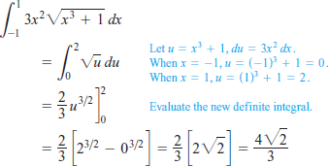
Substitution and Area Between Curves
Substitution in Definite Integrals
If g' is continuous on the interval [a, b] and ƒ is continuous on the
range of g, then.
EXAMPLE 8:

Slide 9
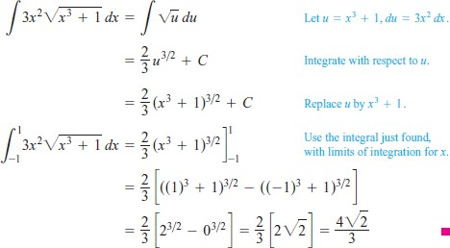

Slide 10
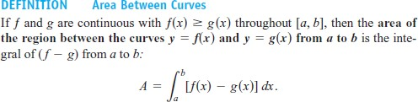
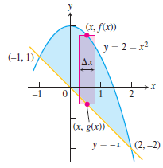

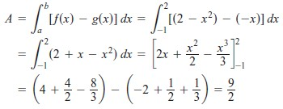
˝Area Between Curves
EXAMPLE 9:

Slide 11
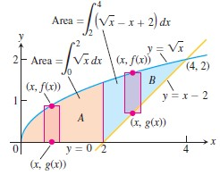
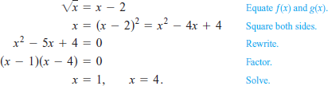
EXAMPLE 10:
Solution:
We subdivide the region at into subregions A and B, shown in Figure we solve the equations

Slide 12

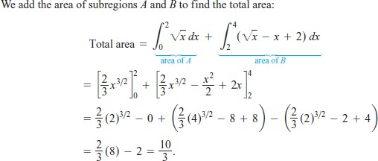

Slide 13
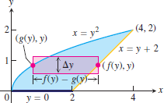
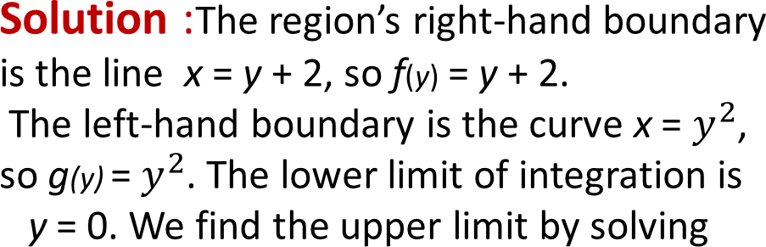

EXAMPLE 11:
Find the area of the region in Example 5 by integrating with respect to y.

Slide 14
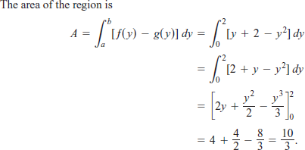

Slide 15
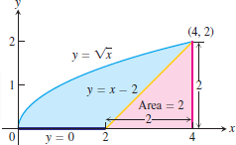
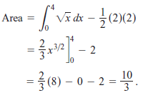
The way to find an area may be to combine calculus and geometry.
˝Combining Integrals with Formulas from Geometry
EXAMPLE 12: Find the area of the region, shown in figure,
Solution:

Slide 16
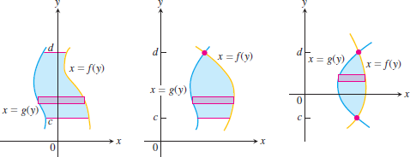
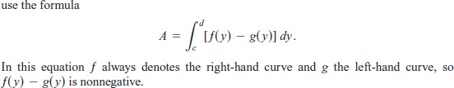
˝Integration with Respect to y
If a region’s bounding curves are described by functions of y, the approximating rectangles are horizontal instead of vertical and the basic formula has y in place of x. For regions like these.

Slide 17






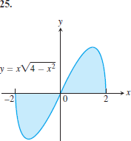
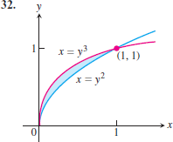
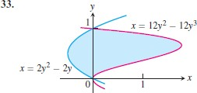
EXERCISES 6:
1. Use the Substitution Formula to evaluate the integrals in Exercises.
2. Find the total areas of the shaded regions in Exercises

Slide 18
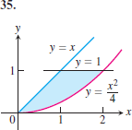
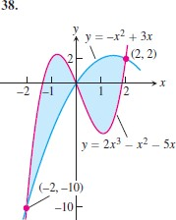
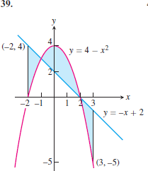

3. Find the areas of the regions enclosed by the lines and curves in Exercises .
4. Find the areas of the regions enclosed by the curves in Exercises.

Slide 19
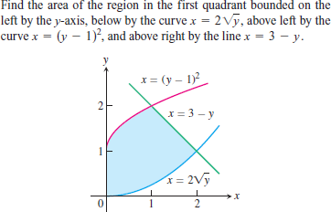
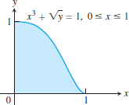
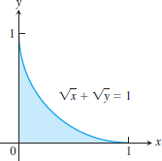
9.
10.
1.
2.

